Slide 1
Introduction to Ember.js
-OR- How to make web apps and do other stuff good too

Slide 2
What is Ember.js?
It’s a framework designed for ambitious web applications, specifically for single page web apps.
Ember.js tries to capitalize on the one major aspect of the web – sharable urls.
It’s a combination of proven libraries and idioms to rapidly let you create your application without re-inventing the wheel.

Slide 3
Ember.js Fundamentals
It’s important to note that Ember.js relies on convention instead of configuration for development, as well as object hierarchies.
Handlebars templating is used for specifying your UI layouts and some behavior (compared to the declarative style favorite in Angular.js)
You notify on updates VS scanning for updates (more on this later)

Slide 4
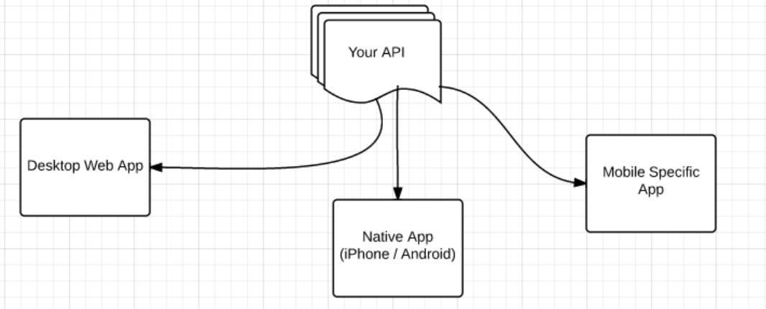
Designing your Application Architecture
Making a web app is now one facet of producing a solution for your business

Slide 5
Ember.js Architecture
Application
Routes
Controllers
Views
Templates
Models
Components

Slide 6

Creating your First App
Takes just one line!
Of course, this doesn’t do much visually since you haven’t written anything else…
All of the logic and code you will write will attach to this namespace and container in memory.
Creating the application starts up the router, checks your route and directs the user to the appropriate page.
By convention, defaults are supplied for missing configuration if necessary.

Slide 7
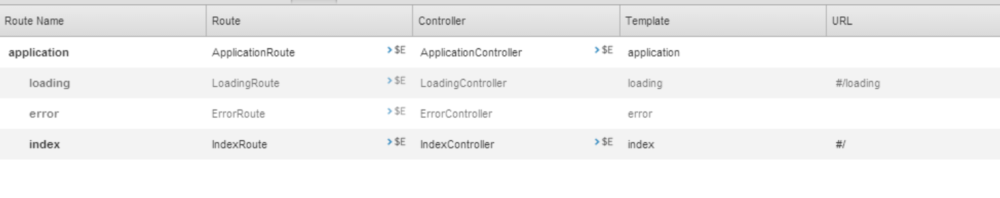
Ember.js Conventions
By creating the app, several default implementations have been created.
Using the Ember Inspector Chrome Extension to visualize:

Slide 8
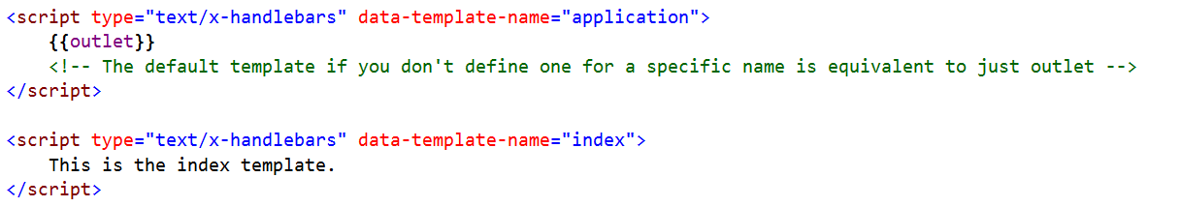
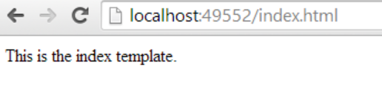
Templates
We can create views by making handlebars templates. The template names match the names of the routes.
If a template doesn’t exist, a default template is created.

Slide 9
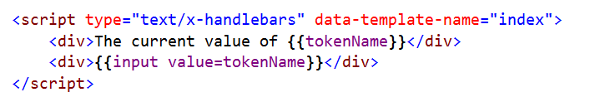
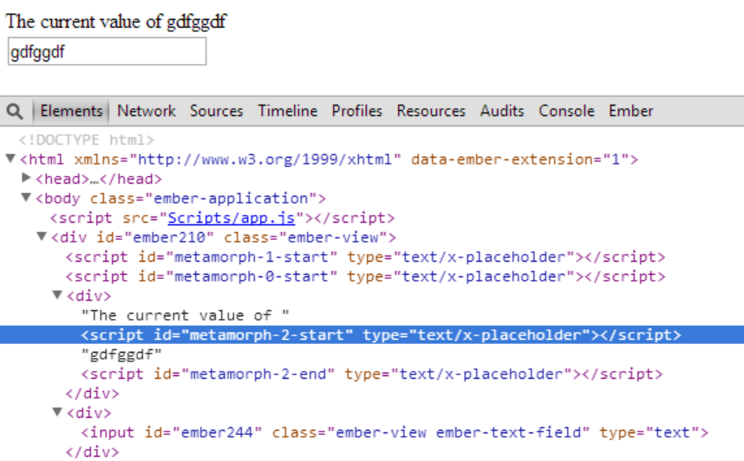

Slide 10
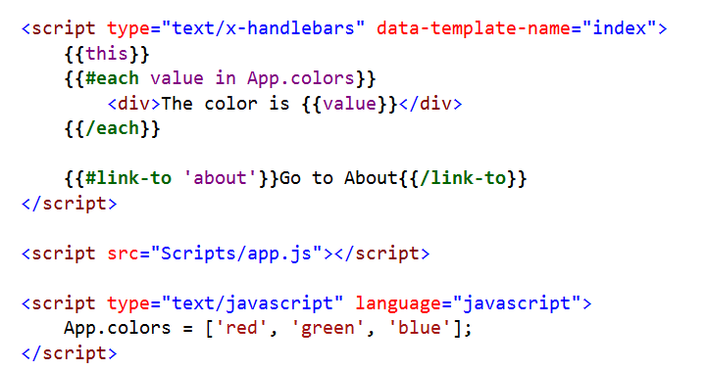
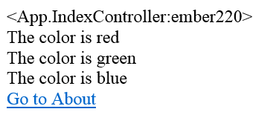

Slide 11
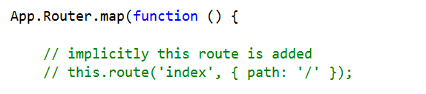
Routing
Routing is how you configure what URL goes where:
In the previous examples, the route for index was automatically created, which is why we get an IndexRoute. However, we can change this via configuration in this extension point, as well as define additional endpoints.
Two modes – defined using the hash on the URL, or via the browser history API. For simplicity, we’ll continue with the hash version.

Slide 12
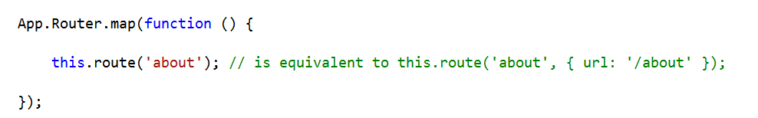
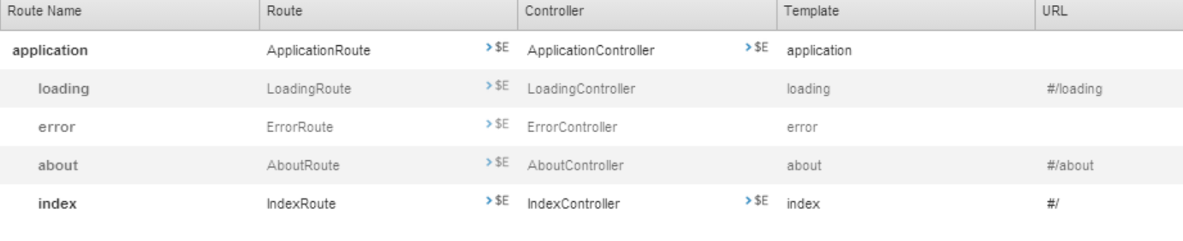
Routing (cont’d)
Let’s define another route:

Slide 13

Nesting Routes

Slide 14
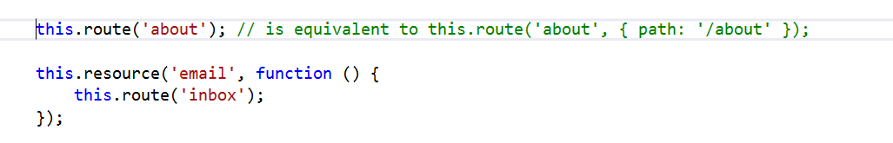
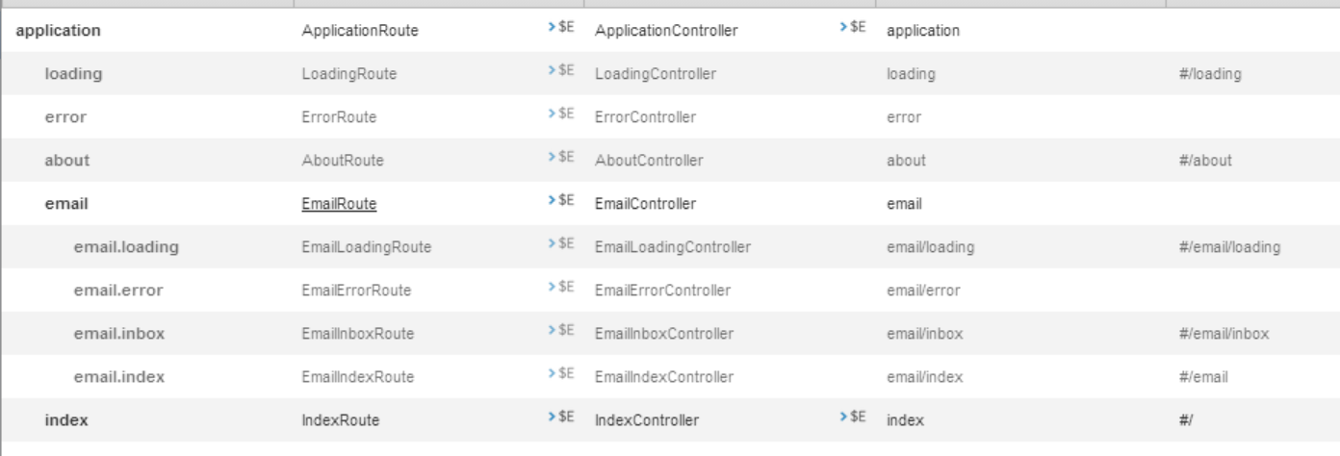

Slide 15
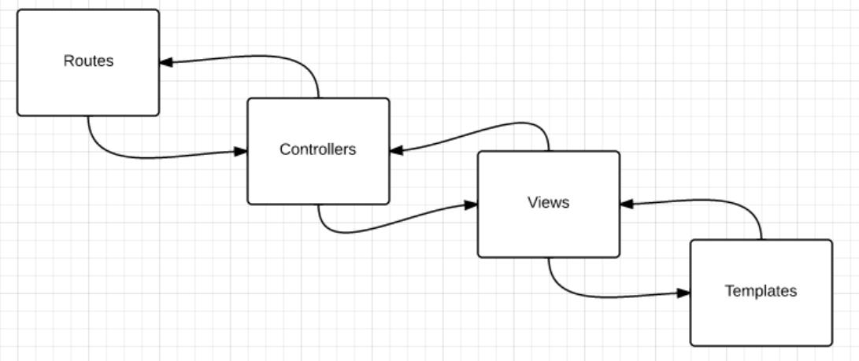
Ember.js Hierarchy

Slide 16
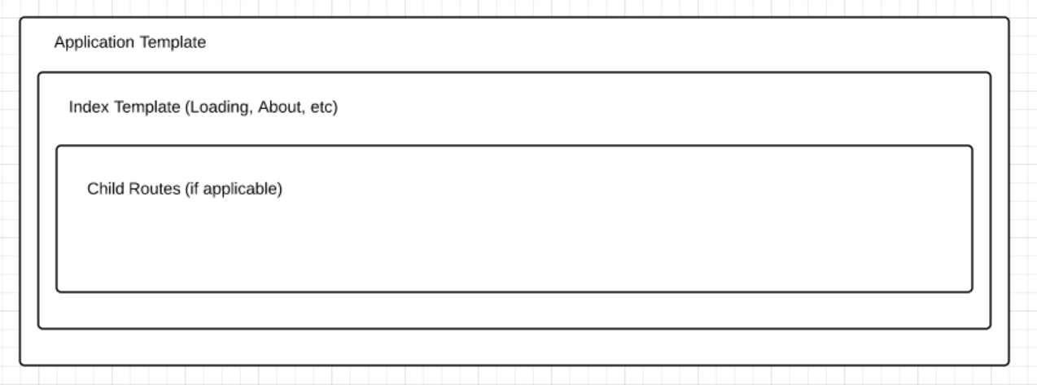

Slide 17
Let’s Dive Into Code!
Routes
Controllers
Views
Templates and Handlebars
Binding Data
Events
Asynchrony
Supporting Tools

Slide 18
Supporting Resources
Node.js for Node Package Manager (npm)
Grunt JavaScript Task Runner (npm install grunt)
Ember Template Compiler (npm install grunt-ember-templates)
Contrib Concat (npm install grunt-contrib-concat)
Ember Inspector Chrome Extension

